Slide 1

Northeastern University - Seattle
CS6650 Building Scalable Distributed Systems
Vishal Rajpal

Slide 2
Week 12 – Scalable Event Driven Processing
Topics we will cover today:
Event Driven Architectures
Apache Kafka
Scalability
Availability
Case Study
Ask Me Anything

Slide 3
Event Driven Architectures
Messaging
RabbitMQ (Week 6)
Widely used open source broker that implements Advanced Message Queuing Protocol
Loosely coupled solutions
Smooth out spikes
Increased responsiveness
Increased availability
Asynchronous Services
Features like message filtering and routing
Message consumption is destructive
New subscribers don’t see old messages
Notes:
Architecture Flexibility
-

Slide 4
Event Driven Architectures
Events represents something interesting has happened
External event – new skier lift ride
State change – drivers license expired
Event source emits events
No expectation on how they are processed
Events are typically published to a message system
Interested services register to receive events, e.g.:
Package bar code scan consumed by microservice that emails client of latest location
Expired license event consumed by microservice that reminds driver to enter new license details
Event source is oblivious to actions triggered

Slide 5
Event Driven Architectures
Implement using a message broker/pub-sub (RabbitMQ)
Destructive messaging
frees up broker resources
No explicit record of an event
Alternatives:
Keep events in an immutable log
Append only
Sequence number represents order of events

Slide 6
Event Driven Architectures
Example:
Store all package bar code scan events in a log
Capabilities enabled:
# of packages at any location
Time for a packages at locations
Remedial action if package lost
Essentially the log is the single source of truth about where every package is (and was) at any instant

Slide 7
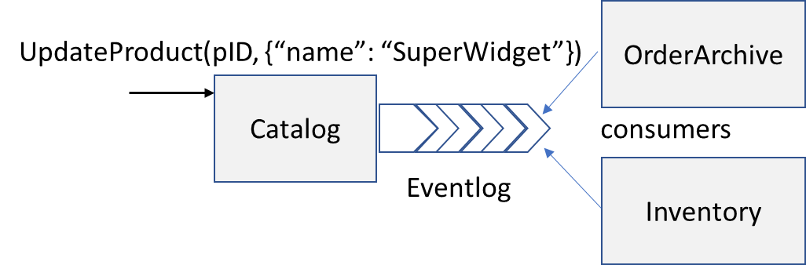
Event Driven Architectures
Example:
Another Common Use - Data replication across microservices
the event log is being used for replication across microservices to implement state transfer.

Slide 8
Event Driven Architectures
Persistent Log Advantages
Introduce new event consumers at any time.
Modify existing event processing logic, either to add new features or fix bugs.
If a server or disk failure occurs, restore the last known state and replay events from the log to restore the data set.
Notes:
You can introduce new event consumers at any time. The log stores a permanent, immutable record of events and a new consumer has access to this complete history of events. It can process both existing and new events.
You can modify existing log processing logic, either to add new features or fix bugs. You can then execute the new logic on the complete log to enrich results or fix errors.
If a server or disk failure occurs, you can restore the last known state and replay events from the log to restore the data set. This is analogous to the role of the transaction log in database systems.

Slide 9
Apache Kafka
Originated at LinkedIn, Apache project in 2012
Distributed persistent log store
Dumb broker – smart clients
Consumers specify the log offset, or index, of the entries they wish to read
Supports highly distributed cluster deployments. Brokers communicate to distribute and replicate event logs.
Highly Scalable architecture with high throughput.
Cluster metadata stored and managed in ZooKeeper
Notes:
Widely used open source messaging system
Zookeeper: https://zookeeper.apache.org/
Apache ZooKeeper is an effort to develop and maintain an open-source server which enables highly reliable distributed coordination.
ZooKeeper is a centralized service for maintaining configuration information, naming, providing distributed synchronization, and providing group services. All

Slide 10
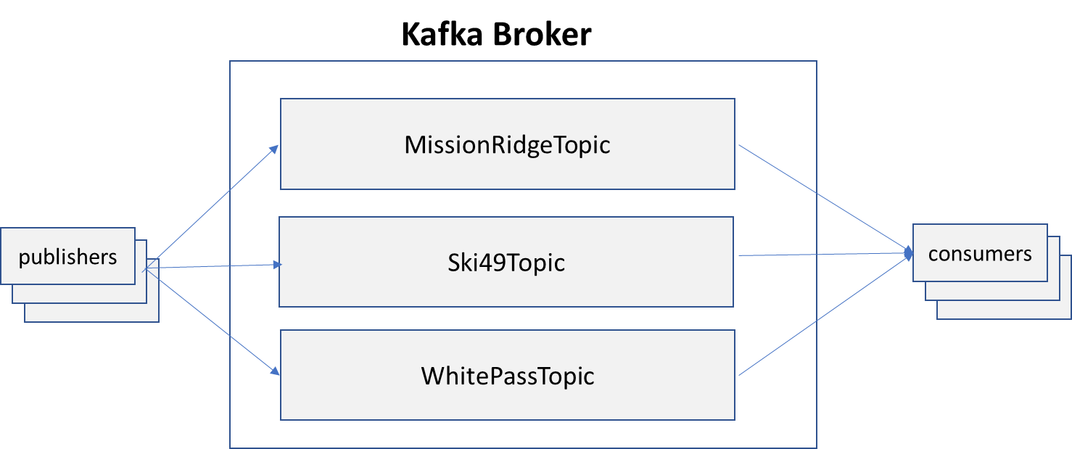
Apache Kafka
Topics
Persistent append only logs
Managed by Kafka broker
Consumer specify message offset in a topic
Message persist until a configurable TTL expires
Exploit OS optimizations to give constant access times regardless of topic size
Notes:
Kafka topics are the equivalent of queues in general messaging technologies. In Kafka, topics are managed by a broker and are always persistent, or durable. One or more producers send events to a topic. Topics are implemented as append-only logs, meaning new events are always written to the end of the log. Consumers read events by specifying the name of the topic they wish to access and the index, or offset of the message they want to read. Reading an event from a topic is non-destructive. Each topic persists all events until a topic-specific configurable event retention period expires. When events have been stored for longer than this retention period, they are automatically removed from the topic. Brokers take advantage of the append-only nature of logs to exploit the linear read and write performance capabilities of disks. Operating systems are heavily optimized for these data access patterns, and use techniques such as pre-fetching and caching of data. This enables Kafka to provide constant access times regardless of the number of events stored in a topic.

Slide 11
Apache Kafka
Producers And Consumers
Events are timestamped Key-Value pairs
Events published asynchronously
Written to local buffer
Sent periodically to broker in batches
One batch is a network round trip
Notes:
Kafka provides APIs for both producers to write events and consumers to read events from a topic. An event has an application defined key and an associated value, and a publisher-supplied timestamp.

Slide 12
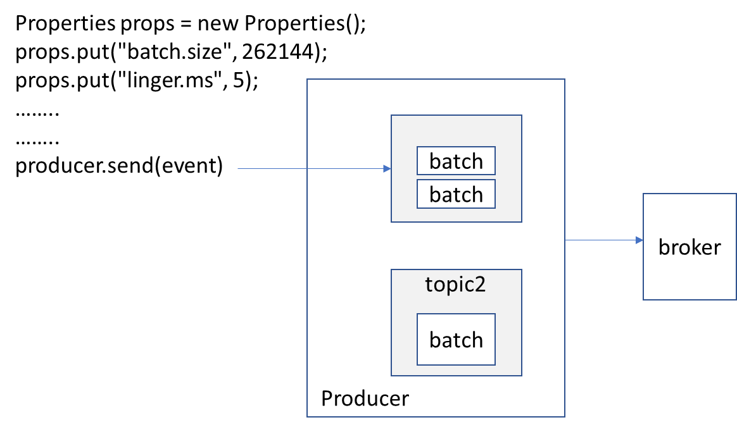
Apache Kafka
Publishing
Notes:
send() is asynchronous. When called it adds the record to a buffer of pending record sends and immediately returns. This allows the producer to batch together individual records for efficiency.
Accumulating events in batches enables Kafka to incur less network round trips to the broker to deliver events. It also enables the broker to perform fewer, large writes when appending event batches to the topic. Together these efficiency measures are responsible for much of the high throughput that a Kafka system can achieve. Buffering events on producers allows you to trade-off the additional latency that is incurred while batches are accumulated (the linger.ms value) for improved system throughput.

Slide 13
Apache Kafka
Producer Example
public Future<RecordMetadata> sendToBroker(final String skierID, final String
liftRideEvent) {
// initialization of producer and resortTopic omitted for brevity
final ProducerRecord<String, String> producerRecord = new
ProducerRecord<>(resortTopic, skierID, liftRideEvent);
return producer.send(producerRecord);
}
Notes:
The following code snippet shows a simple method that sends a ski lift ride event to a topic that represents the resort on the broker. The send() method returns a Future of type RecordMetaData. Calls to Future.get() will block until the broker has appended the event to the topic and returns a RecordMetaData object. This contains information about the event in the log such as its timestamp and offset.

Slide 14
Apache Kafka
Delivery Guarantees
acks configuration parameter
0 provides no delivery guarantee. – fire and forget
1 means an event acknowledged by the broker once persisted to the destination topic.
Exactly once delivery:
Transient network failures may cause the producer to retry failed events, leading to duplicates.
enable-idempotence configuration parameter to true.
Notes:
Transient network failures may cause the producer to retry failed events, leading to duplicates. If you can’t accept duplicates, you can set the enable-idempotence configuration parameter to true. This causes the broker to filter out duplicate events and provide exactly-once delivery semantics.

Slide 15
Apache Kafka
Consumers
while (alive) {
ConsumerRecords<K, V> liftRideEvents = consumer.poll(LIFT_TOPIC_TIMEOUT);
analyze(liftRideEvents);
consumer.commitSync();
}
Notes:
Kafka consumers utilize the pull model to retrieve events in batches from a topic. When a consumer first subscribes to a topic, its offset is set to the first event in the log. You then call the poll() method of the consumer object in an event loop. The poll() method returns one or more events starting from the current offset. The following simple consumer code example shows an event loop that retrieves and processes a batch of events.

Slide 16
Apache Kafka
Consumers
Default: Increments consumer offset automatically to next unprocessed event
Commit sent as part of poll() API
At least once delivery?
Manually commit offset
Before processing batch – at most once delivery
After processing batch – at least once delivery
Can always consumer.seek(topic, offset)
Notes:
Kafka increments the consumer’s offset in the topic automatically to point at to the next unprocessed event in the topic. By default Kafka will automatically commit this value such that the next request to fetch events will commence at the new offset. The commit message is actually sent as part of the poll()method, and this commits the offset returned by the previous poll() request. Should your consumer die, the offset is not committed as poll() is not called. This gives your consumer at-least-once delivery guarantees, as the next fetch will start at the same offset as the previous one.
You can also choose to manually commit the offset in consumers. You do this by calling the consumer.commitSync() API, as shown in the example. If you call commitSync() before you process the events in a batch, the new offset will be committed. This means if the consumer fails while processing the event batch, the batch will not be redelivered. Your consumers now have at-most-once delivery guarantees.
Calling commitSync() after you have processed all the events in a batch, as in the example, gives your consumers at-least-once delivery guarantees. If your consumer crashes while processing a batch of events, the offset will not be committed and when the consumer restarts the events will be redelivered . Consumers can also at any time explicitly set the offset for the topic using the consumer.seek(topic, offset) API.
Note The Kafka consumer is NOT thread-safe. All network I/O happens in the thread of the application making the call. It is the responsibility of the user to ensure that multi-threaded access is properly synchronized. Un-synchronized access will result in ConcurrentModificationException. A common approach is a thread-per-consumer model, which provides a simple solution at the cost of managing moreTCP connections and fetch requests at the broker. An alternative is to have a single thread fetch events and offload event processing to a pool of processing threads. This potentially provides greater scalability, but makes manually committing events more complex as the threads somehow need to coordinate to ensure all events are processed for a topic before a commit is issued.

Slide 17
Scalability
Topic Partitioning
Specify #partitions and Kafka distributes across cluster
Horizontal scaling:
Read and write from different partitions in parallel
Notes:
The primary scalability mechanism in Kafka is topic partitioning. When you create a topic, you specify the number of partitions that should be used for storing events and Kafka distributes partitions across the brokers in a cluster. This provides horizontal scalability as producers and consumers respectively can write to and read from different partitions in parallel.

Slide 18
Scalability
Load Balancing
Producers use bootstrap servers to discover cluster configuration
Which partitions allocated to which brokers?
Producers choose how to distribute events across partitions
DefaultPartitioner
Uses event key and hash function
Notes:
When a producer starts, you specify a list of host/port pairs to connect to the cluster using the Properties object
The producer connects to these servers to discover the cluster configuration in terms of broker IP addresses and which partitions are allocated to which brokers.
In tune with the ‘dumb broker’ architecture that Kafka implements, producers, not the broker, are responsible for choosing the partition that an event is allocated to. This enables the broker to focus on its primary purpose of receiving, storing and delivering events. By default, your producers use the DefaultPartitioner class provided by the Kafka API.

Slide 19
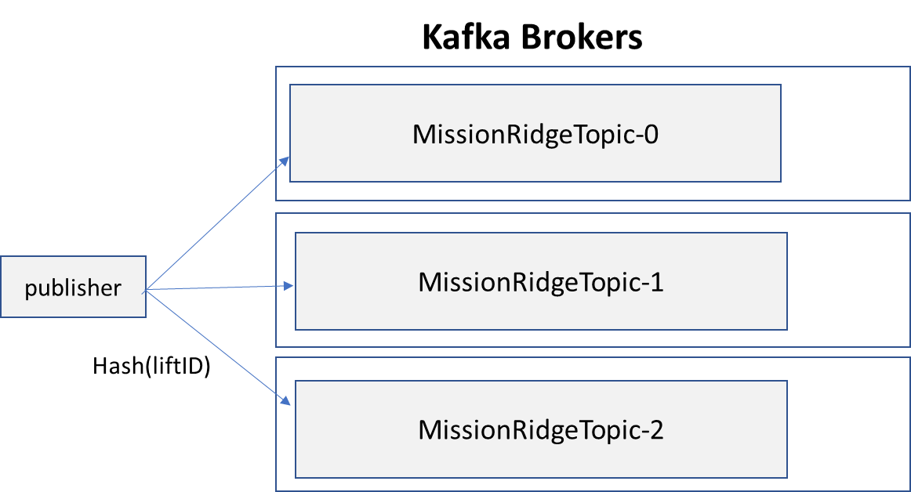
Scalability
Topic Partitioning
Notes:
If you do not specify an event key (i.e. the key is null), the DefaultPartitioner sends batches of messages to topic partitions in a round-robin fashion. When you specify an event key, the partitioner uses a hash function on the key value to choose a partition. This directs events with the same key to the same partition, which can be useful for consumers that process events in aggregates. For example, in the ski resort system, you could use a liftID as a key to ensure all lift ride events on the same lift at the same resort are sent to the same partition. Or you could use skierID to ensure all lift rides for the same skier are sent to the same partition. This is commonly called semantic partitioning.
Partitioning a topic has an implication for event ordering. Kafka will write events to a single partition in the order they are generated by a producer, and events will be consumed from the partition in the order they are written. This means events in each partition are ordered by time, and provide a partial ordering of the event stream.

Slide 20
Scalability
Topic Partitioning
No total order of events across partitions
Can increase #partitions
Cannot decrease the #partitions!
Same keys can be hashed to different partitions after increase

Slide 21
Scalability
Consumer Groups
Partitions enable concurrent event delivery to multiple consumers
Consumer Group:
comprises one or more consumers for a topic, up to a maximum of the number of partitions
Kafka allocates each consumer in the group to exactly one partition
Notes:
Partitions also enable concurrent event delivery to multiple consumers. To achieve this, Kafka introduces the concept of consumer groups for a topic. A consumer group comprises one or more consumers for a topic, up to a maximum of the number of partitions configured for a topic. There are basically three consumer allocation alternatives depending on the number of topic partitions and the number of subscribers in the group:
If the number of consumers in the group is equal to the number of partitions, Kafka allocates each consumer in the group to exactly one partition.
If the number of consumers in the group is less than the number of partitions, some consumers will be allocated to consume messages from multiple partitions,
If the number of consumers in the group exceeds the number of partitions, some consumers will not be allocated a partition and remain idle.

Slide 22
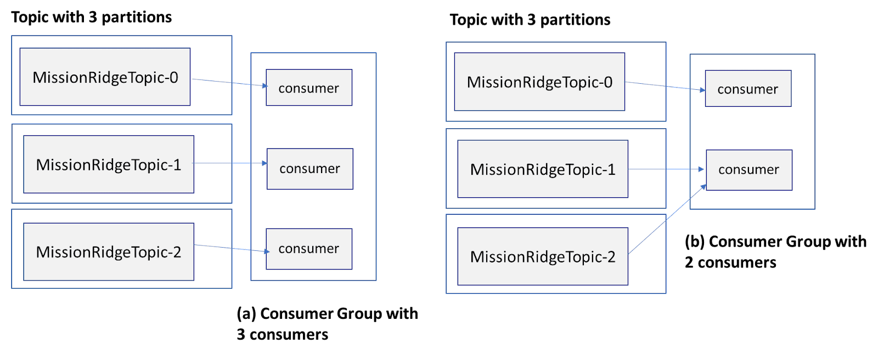
Scalability
Consumer Groups

Slide 23
Scalability
Rebalancing
rebalancing mechanism for consumer groups.
New joins or existing leaves
Each group has a broker coordinator
Tracks subscriptions/membership
Triggers rebalance when members change
all topic partitions are allocated to a consumer from the group
all consumer group members are allocated one or more partitions.
Notes:
Kafka implements a rebalancing mechanism for consumer groups. This is triggered when a new consumer joins or an existing consumer leaves the group, or new partitions are added to a topic. For each consumer group, Kafka allocates one broker as the group coordinator. The coordinator tracks the partitions of topics and the members and subscriptions in the consumer group. If the number of topic partitions or group membership changes, the coordinator commences a rebalance. The rebalance must ensure that all topic partitions are allocated to a consumer from the group and all consumer group members are allocated one or more partitions.
To perform a rebalance, Kafka chooses one consumer from a group chosen as the group leader. When the rebalance is invoked, the group coordinator on the broker informs the consumer group leader of the existing partition assignments to the group members and the configuration changes needed. The consumer group leader decides how to allocate new partitions and group members, and may need to reassign existing partitions across group members. Moving a partition between consumers requires the current owner to first relinquish its subscription. To trigger this change, the group leader simply removes these subscriptions from the consumer’s allocations and sends the new partition assignments to each consumer.

Slide 24
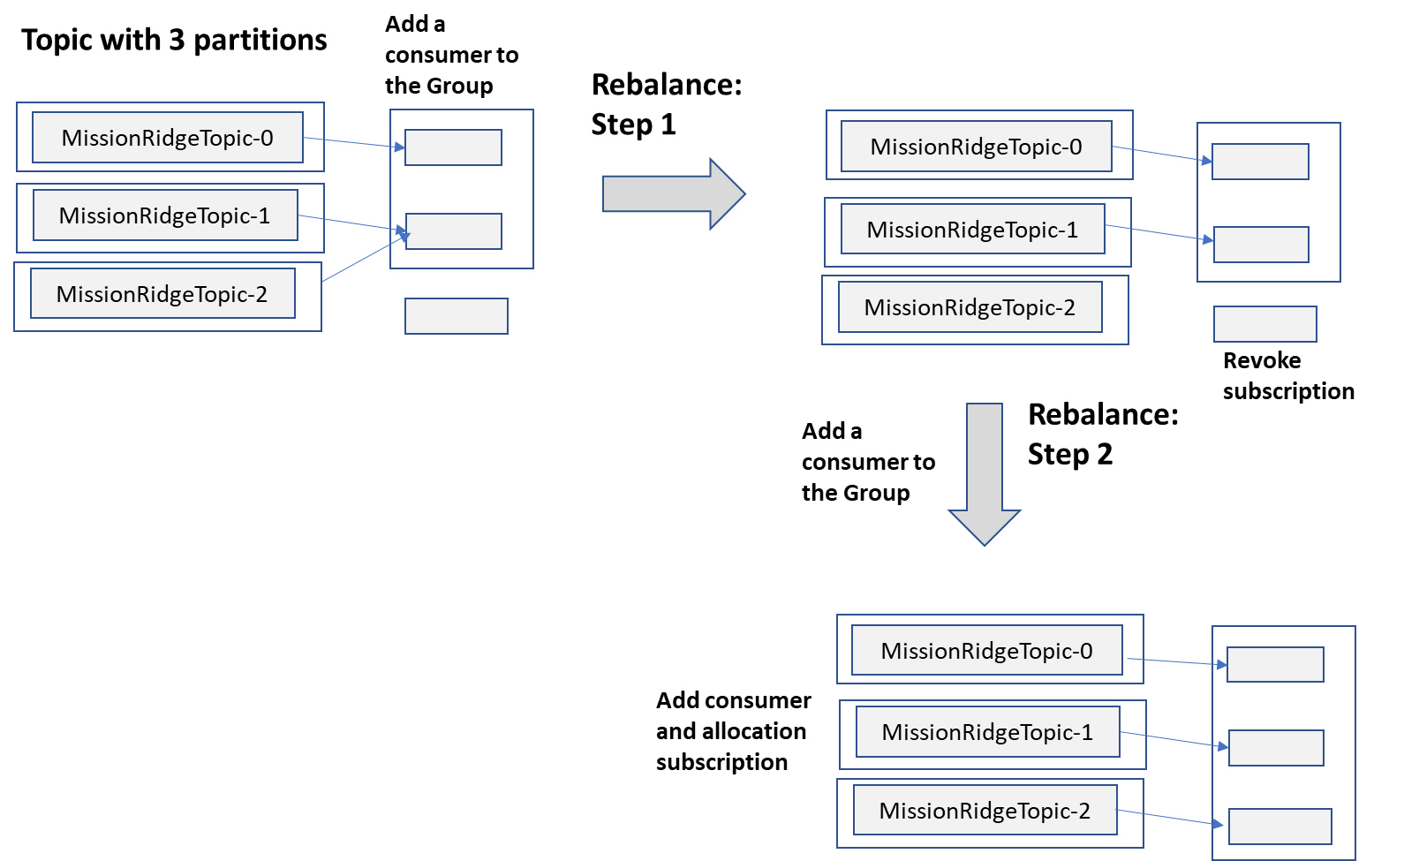
Scalability
Rebalancing
Notes:
In reality, most rebalances require very few partition reassignments. Kafka’s rebalancing approach exploits this fact and enables consumers to keep processing messages while the rebalance proceeds. The group coordinator on the broker also has minimal involvement, basically just orchestrating the rebalances. The group leader is responsible for making partition reassignments. This simplifies the broker - dumb broker architecture, remember - and makes it possible to inject custom partition allocation algorithms for groups through a pluggable client framework. Kafka provides a CooperativeStickyAssignor out of the box, which maintains as many existing partition assignments as possible during a rebalance.

Slide 25
Availability
Topics can have a replication factor
Replicate every topic partition N times
Leader follower architecture
Notes:
When you create a topic in Kafka, you can specify a replication factor of N. This causes Kafka to replicate every partition in the topic N times using a leader-follower architecture.

Slide 26
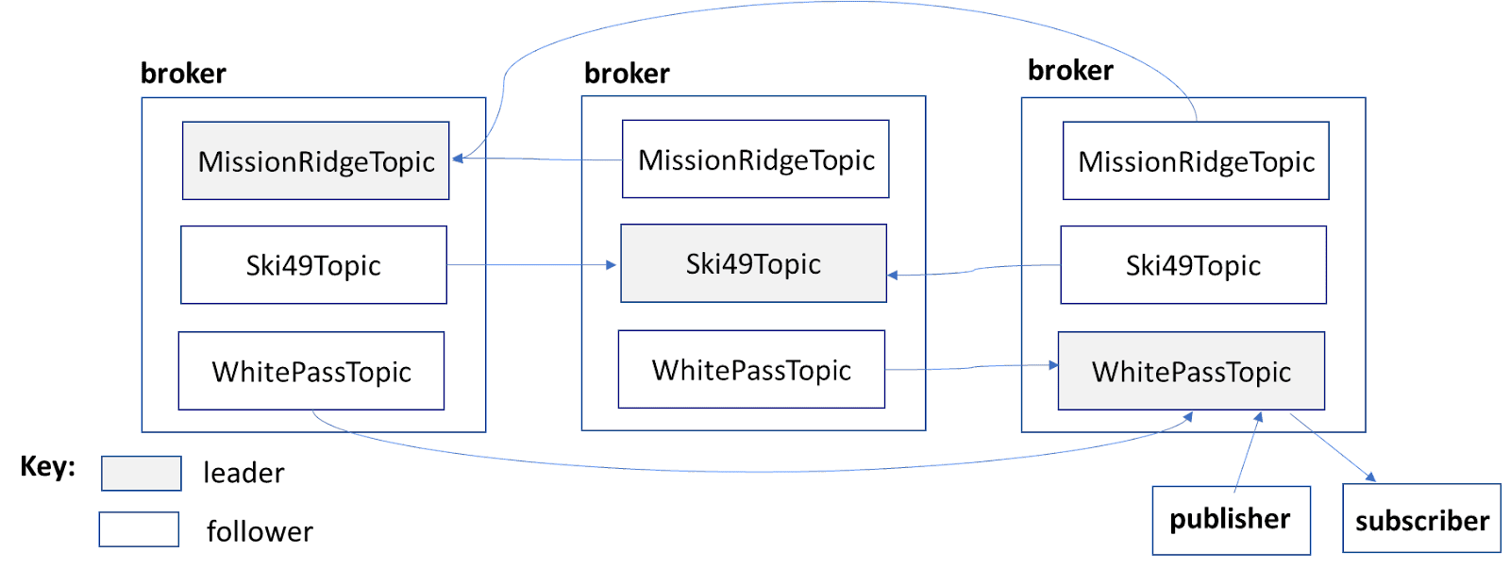
Availability
Partition Allocation
Notes:
Kafka attempts to allocate leaders to different brokers and deploy replicas to different broker instances to provide crash resilience. An example of a replicated partition for the skier management system topics with N=3 is shown in Figure 14-8.
Producers and consumers always write and read from the leader partitions, as shown just for the WhitePassTopic in Figure 14-8. Followers also behave as consumers from their associated leader, fetching messages at a period specified by the replica.fetch.wait.max.ms configuration parameter (default 500ms).

Slide 27
Availability
Leader Failure
If a leader fails, Kafka can automatically failover to one of the followers
The leader broker maintains a list of replicas that are up to date with the leader.
the in-sync replica (ISR) list,
persisted in ZooKeeper so that it is available in the event of leader failure.
Custom leader election algorithm ensures that only members of the ISR can become leaders.
Producers can specify acks=all for data safety
the leader will not acknowledge a batch of events until they have been persisted by all ISRs.
A topic can specify the minimum ISRs - min.insync.replicas - required to acknowledge a successful write. If the number of ISRs falls below this value, writes will fail.
Notes:
If a leader fails, Kafka can automatically failover to one of the followers so that the partition remains available. The leader broker dynamically maintains a list of replicas that are up to date with the leader. This list, known as the in-sync replica (ISR) list, is persisted in ZooKeeper so that it is available in the event of leader failure. Kafka’s custom leader election algorithm ensures that only members of the ISR can become leaders.
In a replicated deployment, producers can specify acks=all for data safety when publishing events. With this setting, the leader will not acknowledge a batch of events until they have been persisted by all ISRs. A topic can specify the minimum ISRs - min.insync.replicas - required to acknowledge a successful write. If the number of ISRs falls below this value, writes will fail. For example, you can create a topic with a replication factor of 3, and set min.insync.replicas to 2. Send operations will succeed as long as the majority, namely the leader and one follower, have received the write. Applications can therefore trade-off data safety and latency versus availability by tuning the minimum ISRs value to meet requirements.

Slide 28
Summary
Event Driven Architectures
Apache Kafka
Scalability

Slide 29
Ask Me Anything
Example Topics
Day in Life at Work
Difference between school projects and work projects
Resumes.
Interviews.
Software engineering roles.
Career growth.
Motivations for teaching.
Your questions here

